Slide 1
Regression
Lecture 06

Slide 2
Regression
Technique used for the modeling and analysis of numerical data
Exploits the relationship between two or more variables so that we can gain information about one of them through knowing values of the other
Regression can be used for prediction, estimation, hypothesis testing, and modeling causal relationships

Slide 3
Regression versus Classification
Classification: the output variable takes class labels
Regression: the output variable takes continuous values

Slide 4
Examples
Predicting House Value
Actual Price: £100,000
Predicted 1: £99,950 (Very Good Prediction)
Predicted 2: £50,000 (Very Bad Prediction)
Predicting Car Premium
Using Location, Age, History etc

Slide 5
Regression Techniques
Linear Regression
Polynomial Regression
Logistic Regression
Ridge Regression
Lasso Regression
And many more

Slide 6
Recall the Learning Pipeline
Training Set
Learning Algorithm
Test Set
Hypothesis
Prediction

Slide 7
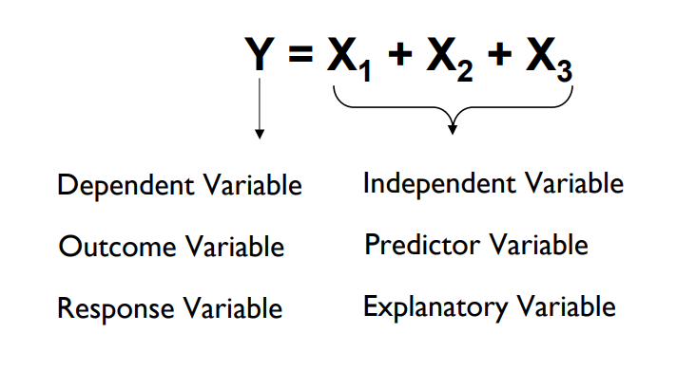
Regression Lingo

Slide 8
Linear Regression
Linear Equation: An equation that makes a straight line when it is graphed. Often written in the form y = mx+b. Equation of a Straight Line.
Linear regression attempts to model the relationship between two variables by fitting a linear equation to observed data.

Slide 9
Wrong Interpretation!
Wrong!!
A linear regression model assumes that the relationship between the dependent variable y_{i} and the independent variables x_{i} is linear.
Correct!!
The linearity is NOT in terms of x but the parameters (coefficients).

Slide 10
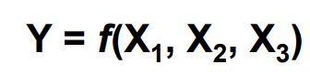
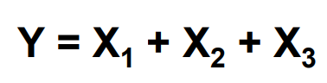
Why Linear Regression?
Suppose we want to model the dependent variable Y in terms of three predictors,
Typically will not have enough data to try and directly estimate f
Therefore, we usually have to assume that it has some restricted form, such as linear

Slide 12
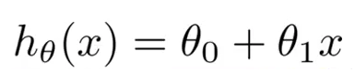
Hypothesis

Slide 13
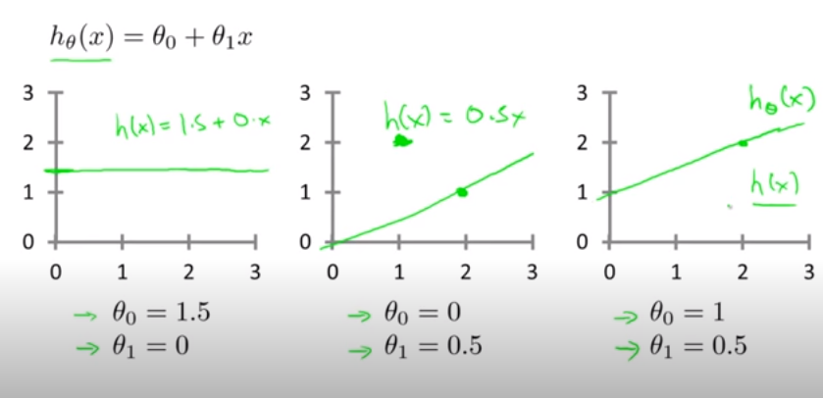
Different Choices of parameters (θ’s)

Slide 14
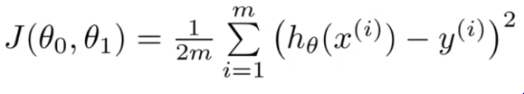
Cost Function
Idea: Choose θ₀ , θ₁ so that h_{θ}(x) is close to y for our training examples (x, y).

Slide 15
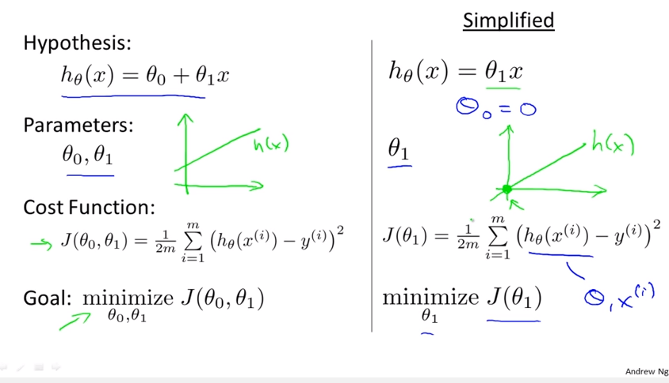
Cost Function

Slide 16
Minimizing Error

Slide 17
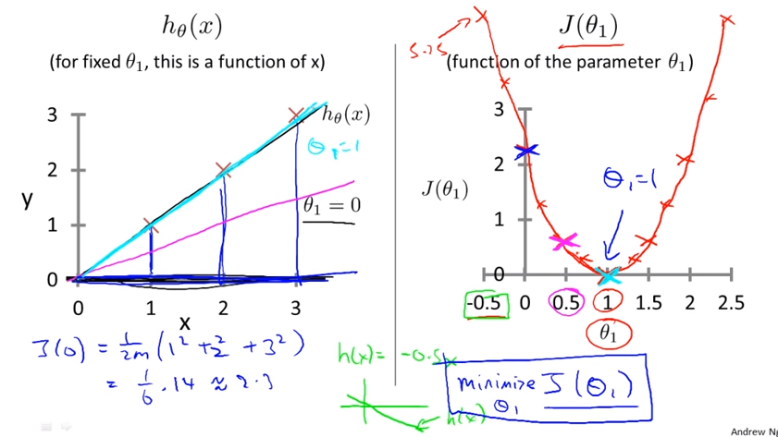
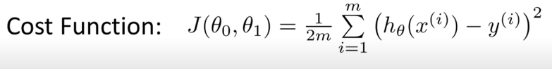
Mean Squared Error

Slide 18
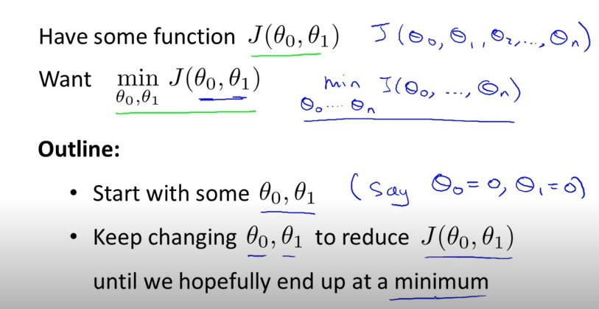
Gradient Descent

Slide 19
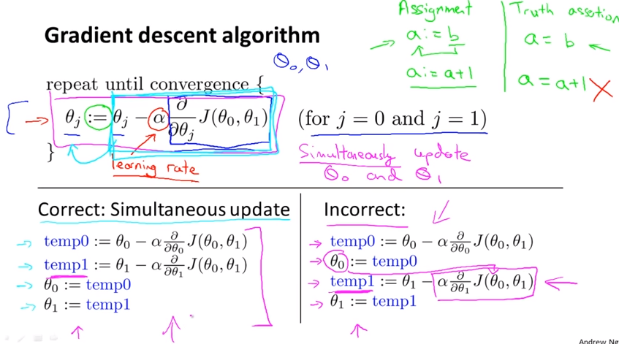

Slide 20
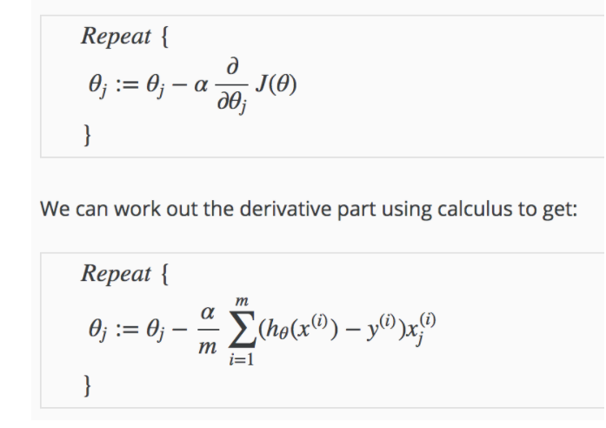
Gradient Descent Algorithm

Slide 21
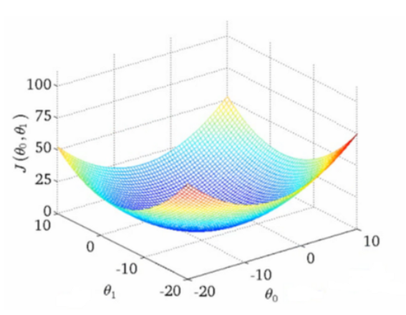
Cost Function in 2D

Slide 22
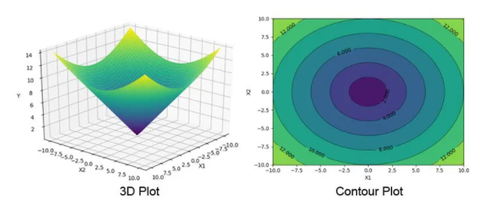
3D & Contour Plots

Slide 23
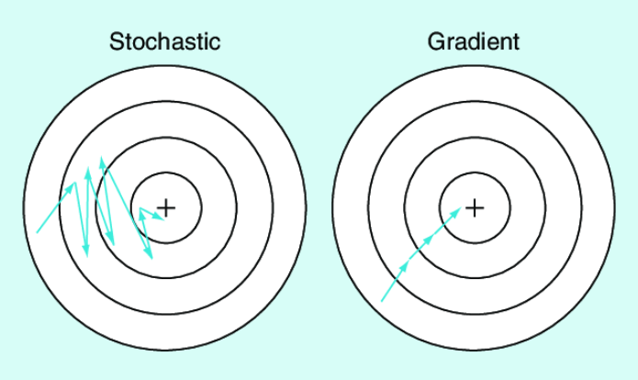
Stochastic Gradient Descent

Slide 24
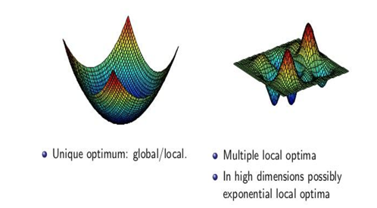
Non-Convex Cost Function

Slide 25
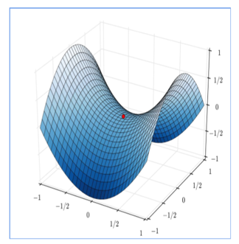
Saddle Point
There is also a saddle point. This is a point in the data where the gradient is zero but it is not an optimal point.
We don’t have a specific way
to avoid this point and it is still
an active area of research

Slide 26
Different Loss Function
Sum of Errors (SE)
Ordinary Least Square (OLS)
Sum of Absolute Errors (SAE)
Sum of Squared Errors(SSE)
Mean Squared Errors (MSE)
Root Mean Squared Error (RMSE)
etc.

Slide 27
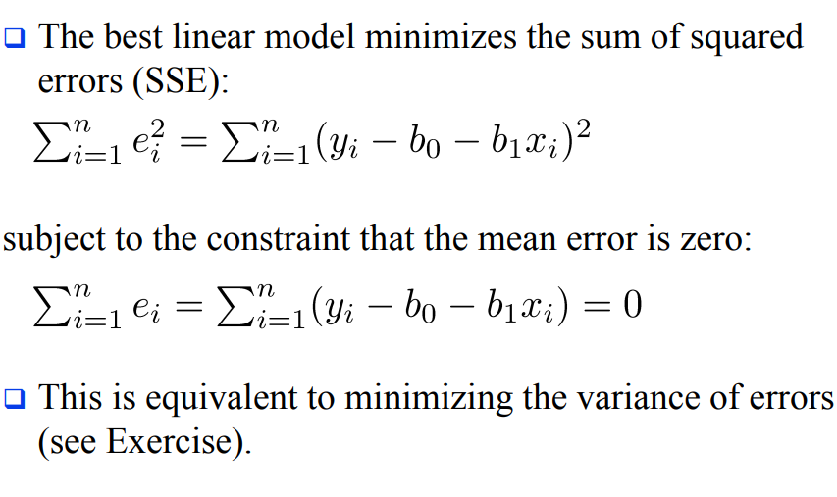
Sum Squared Error

Slide 28
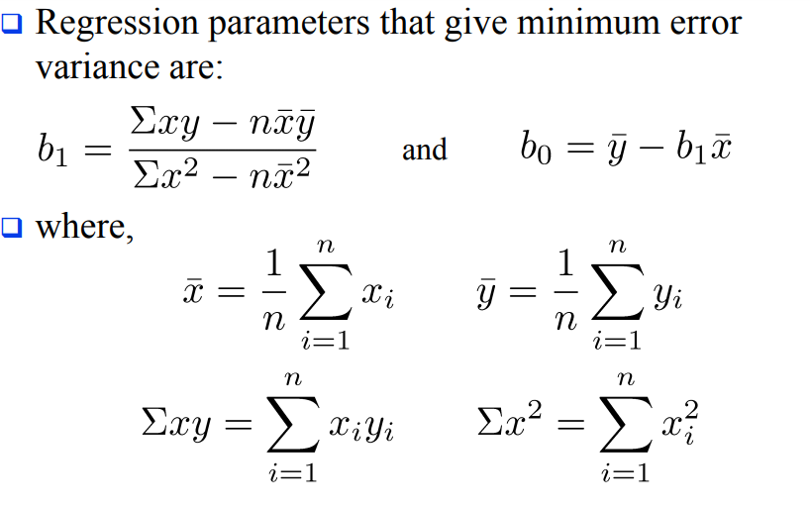
Estimation of Model Parameters

Slide 29
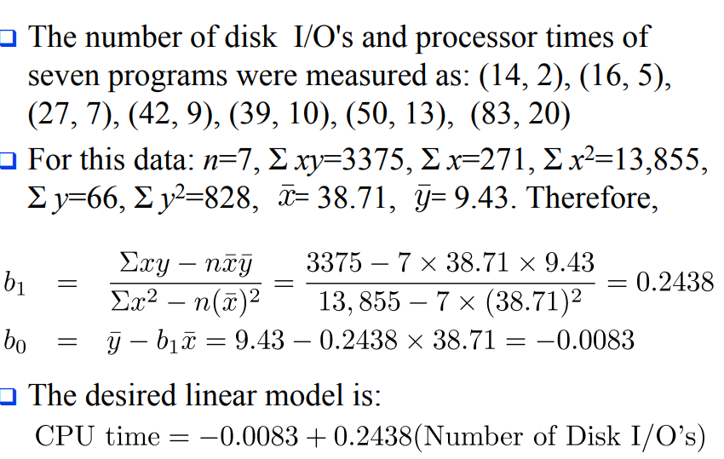
Example

Slide 30
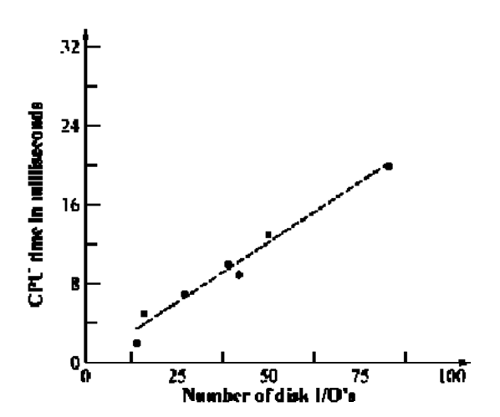

Slide 31
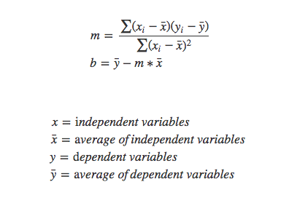
Ordinary Least Squares (OLS) Method
To use OLS method, we apply the below formula to find the equation

Slide 32
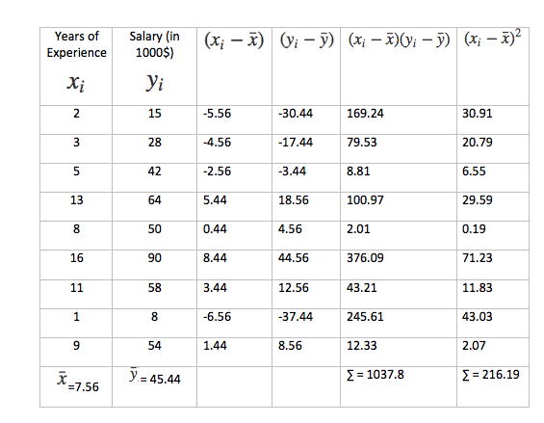
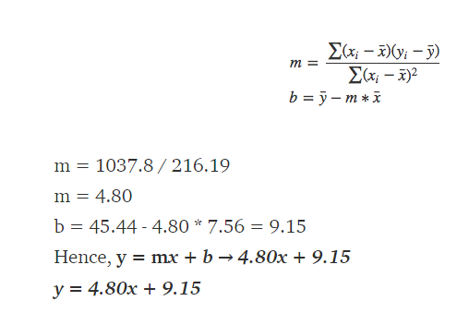
Example

Slide 33
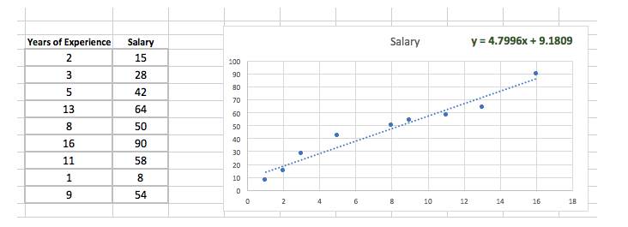
Example

Slide 34
Improving Accuracy
OLS doesn’t consider which independent variable is more important than others.
It simply finds the coefficients for a given data set. In short, there is only one set of betas to be found, resulting in the lowest ‘Residual Sum of Squares (RSS)’.
The question then becomes “Is a model with the lowest RSS truly the best model?”.

Slide 35
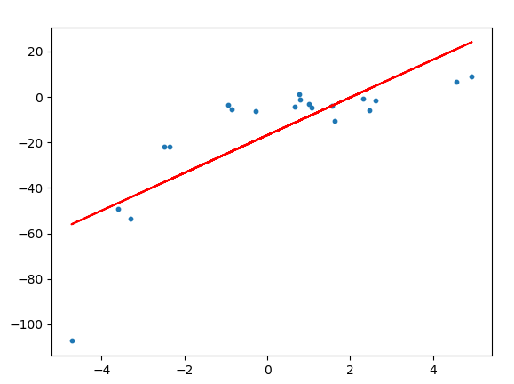
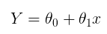
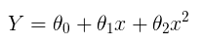
Polynomial Regression
We can see that the straight line is unable to capture the patterns in the data. This is an example of under-fitting.
To overcome under-fitting, we need to increase the complexity of the model.
To generate a higher order equation we can add powers of the original features as new features. The linear model,
can be transformed to

Slide 36
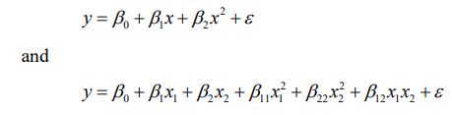
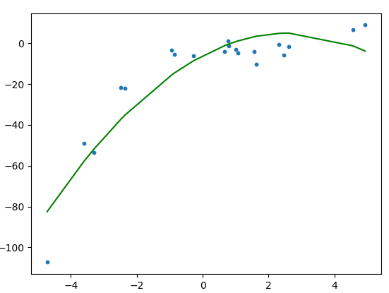
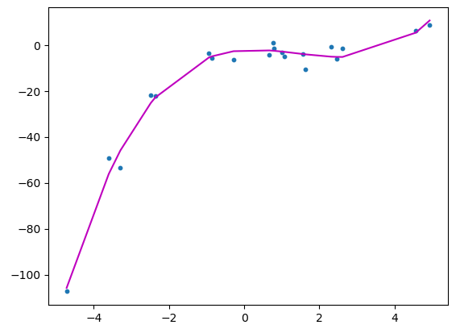
Polynomial Regression
A model is said to be linear when it is linear in parameters. So the model
are also the linear model. In fact, they are the second-order polynomials in one and two variables, respectively.
The polynomial models can be used in those situations where the relationship between study and explanatory variables is curvilinear.

Slide 37
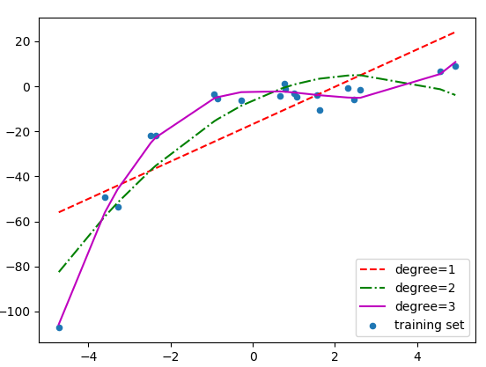
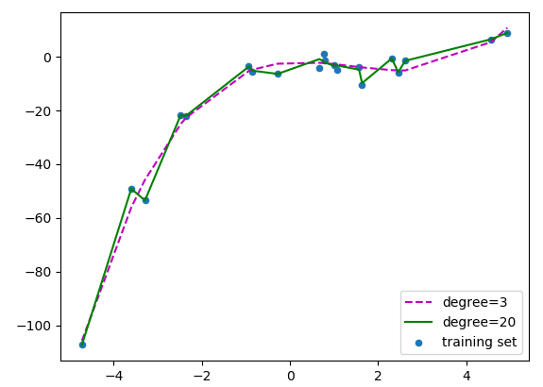
Polynomial Regression
fitting linear, quadratic and cubic curves on the dataset.
The curves for degree 3 and 20.

Slide 38
Model Interpretability
When we have a large number of attributes in the model, there will generally be many that have little or no effect on the response
Including such irrelevant variable leads to unnecessary complexity
Leaving these variables in the model makes it harder to see the effect of the important variables
The model would be easier to interpret by removing (i.e. setting the coefficients to zero) the unimportant variables

Slide 39
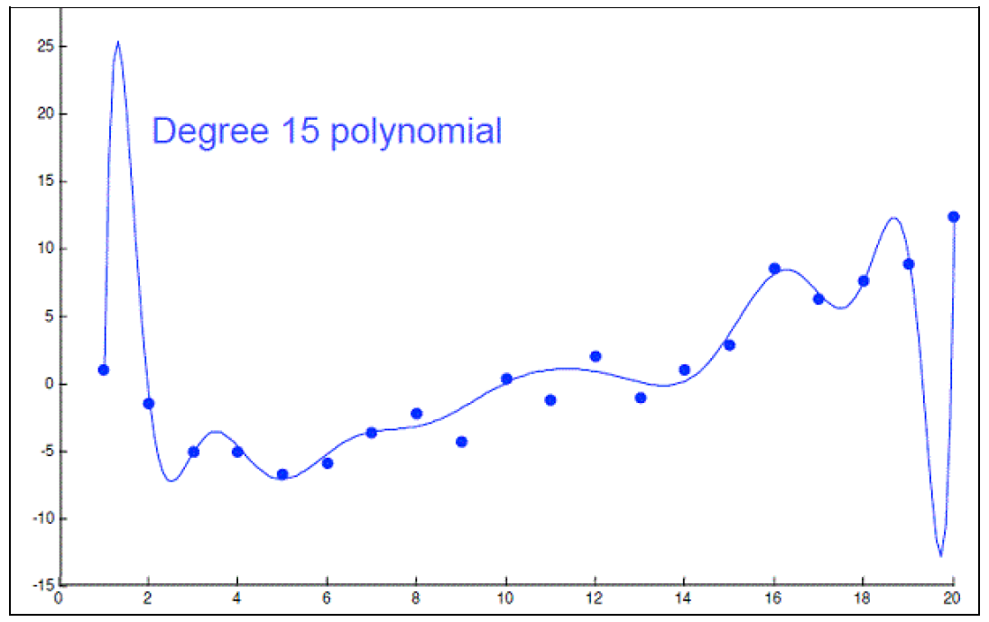
Feature/Variable Selection
Carefully selected features can improve model accuracy, but adding too many can lead to overfitting
Overfitted models describe random error or noise instead of any underlying relationship
They generally have poor predictive performance on test data
For instance, we can use a 15-degree polynomial function to fit the following data so that the fitted curve goes nicely through the data points
However, a brand new dataset collected from the same population may not fit this particular curve well at all

Slide 40
Feature/Variable Selection (cont.)
Subset Selection
Identify a subset of the p predictors that we believe to be related to the response; then, fit a model using OLS on the reduced set.
Methods: best subset selection, stepwise selection
Shrinkage (Regularization)
Involves shrinking the estimated coefficients toward zero relative to the OLS estimates; has the effect of reducing variance and performs variable selection.
Methods: ridge regression, lasso
Dimension Reduction
Involves projecting the p predictors into a M-dimensional subspace, where M < p, and fit the linear regression model using the M projections as predictors.
Methods: principal components regression, partial least squares

Slide 41
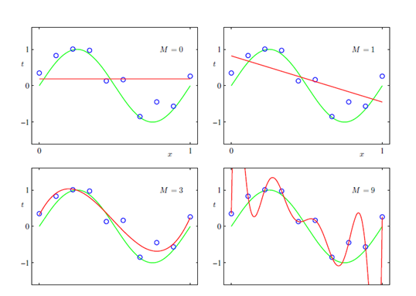
Regularization
Regularizations are techniques used to reduce the error by fitting a function appropriately on the given training set and avoid overfitting.
The graph of target variable vs input variable i.e y= sin(2πx). Blue circles are the training data-points. Green curve is the expected polynomial function which fits the training data set and red curve is the polynomial function of various degrees (given by variable M) that are trained to fit the data set.

Slide 42
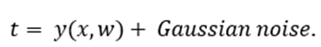
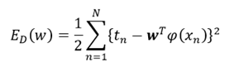
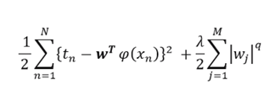
Regularization
The dataset with a target variable t consisting of actual value with some added Gaussian noise.
The sum of square error for the above dataset is defined by:
the regularization co-efficient, our overall cost function becomes

Slide 43
Regularization
Where, if q=1, then it is termed as lasso regression or L1 regularization, and if q=2, then it is called ridge regression or L2 regularization. If both the terms L1 regularization and L2 regularization are introduced simultaneously in our cost function, then it is termed as elastic net regularization.

Slide 44
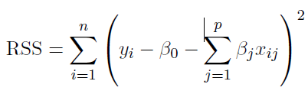
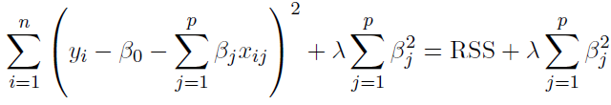
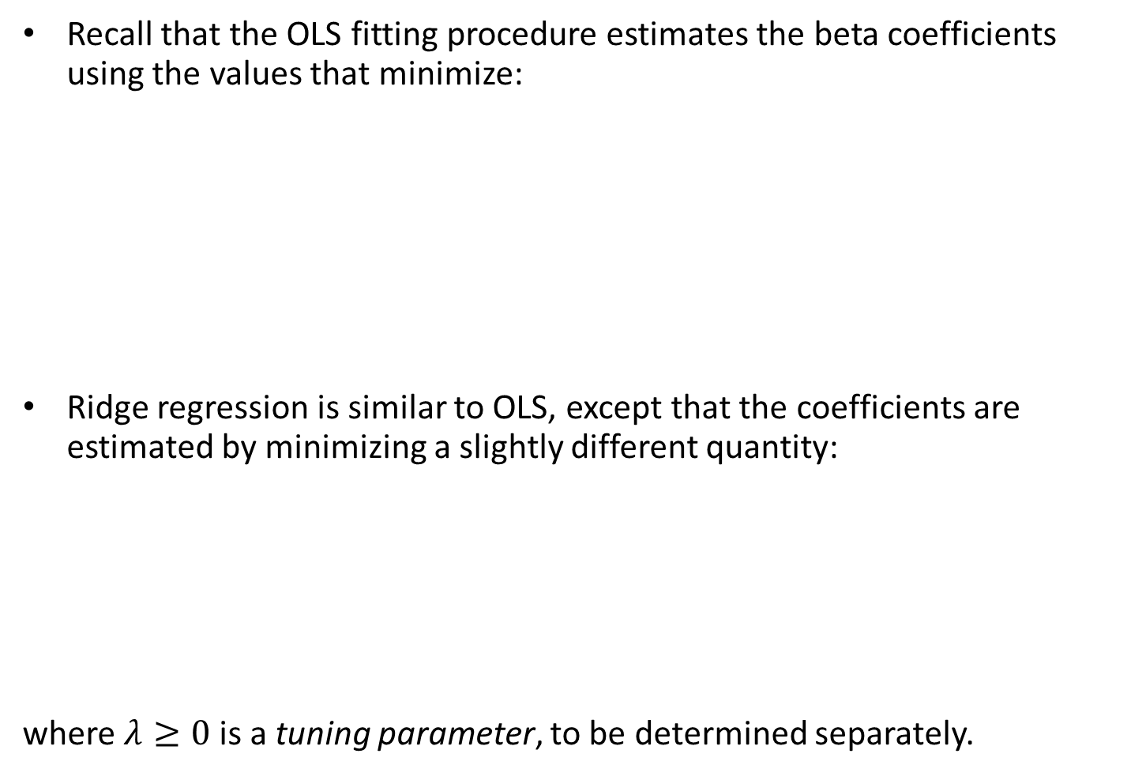
Ridge Regression
Recall that the OLS fitting procedure estimates the beta coefficients using the values that minimize:
Ridge regression is similar to OLS, except that the coefficients are estimated by minimizing a slightly different quantity:
where $λ≥0$ is a tuning parameter, to be determined separately.

Slide 45
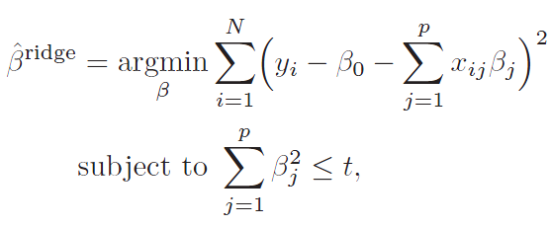

Ridge Regression (cont.)
Note that $λ≥0$ is a complexity parameter that controls the amount of shrinkage.
The idea of penalizing by the sum-of-squares of the parameters is also used in neural networks, where it is known as weight decay.
An equivalent way to write the ridge problem is:

Slide 46
Ridge Regression (cont.)
The effect of this equation is to add a shrinkage penalty of the form
where the tuning parameter λ is a positive value.
This has the effect of shrinking the estimated beta coefficients towards zero. It turns out that such a constraint should improve the fit, because shrinking the coefficients can significantly reduce their variance.
Note that when λ = 0, the penalty term as no effect, and ridge regression will procedure the OLS estimates. Thus, selecting a good value for λ is critical (can use cross-validation for this).

Slide 47
Ridge Regression (cont.)
As λ increases, the standardized ridge regression coefficients shrinks towards zero.
Thus, when λ is extremely large, then all of the ridge coefficient estimates are basically zero; this corresponds to the null model that contains no predictors.

Slide 48
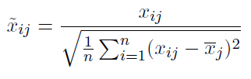
Ridge Regression (cont.)
The standard OLS coefficient estimates are scale equivariant
However, the ridge regression coefficient estimates can change substantially when multiplying a given predictor by a constant, due to the sum of squared coefficients term in the penalty part of the ridge regression objective function
Thus, it is best to apply ridge regression after standardizing the predictors:

Slide 49
Ridge Regression (cont.)
It turns out that the OLS estimates generally have low bias but can be highly variable. In particular when n and p are of similar size or when n < p, then the OLS estimates will be extremely variable
The penalty term makes the ridge regression estimates biased but can also substantially reduce variance
As a result, there is a bias/variance trade-off.

Slide 50
Ridge Regression (cont.)
Black = Bias
Green = Variance
Purple = MSE
Increased λ leads to increased bias but decreased variance

Slide 51
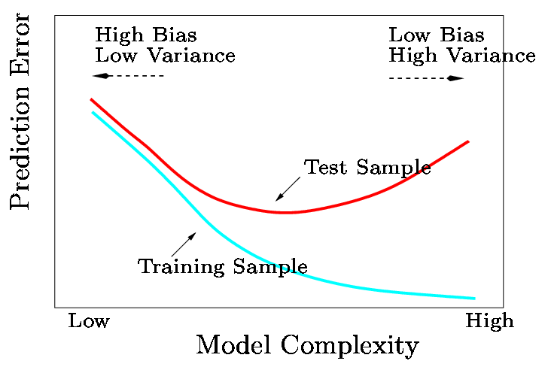
Ridge Regression (cont.)
In general, the ridge regression estimates will be more biased than the OLS ones but have lower variance.
Ridge regression will work best in situations where the OLS estimates have high variance.

Slide 52
The Lasso
One significant problem of ridge regression is that the penalty term will never force any of the coefficients to be exactly zero.
Thus, the final model will include all p predictors, which creates a challenge in model interpretation
A more modern machine learning alternative is the lasso.
The lasso works in a similar way to ridge regression, except it uses a different penalty term that shrinks some of the coefficients exactly to zero.

Slide 53
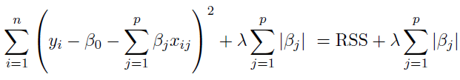
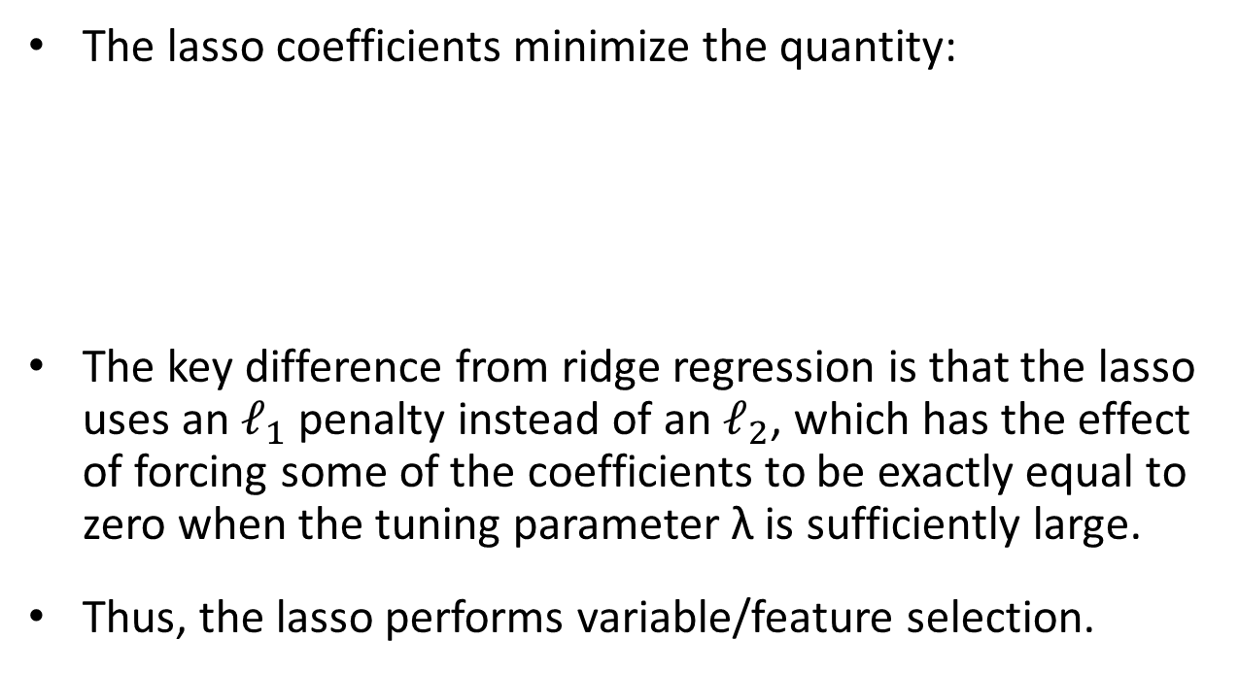
The Lasso (cont.)
The lasso coefficients minimize the quantity:
The key difference from ridge regression is that the lasso uses an $ℓ_{1}$ penalty instead of an $ℓ_{2}$, which has the effect of forcing some of the coefficients to be exactly equal to zero when the tuning parameter λ is sufficiently large.
Thus, the lasso performs variable/feature selection.

Slide 54
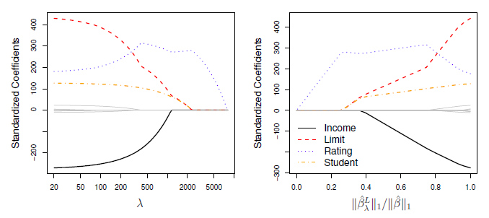
The Lasso (cont.)
When λ = 0, then the lasso simply gives the OLS fit.
When λ becomes sufficiently large, the lasso gives the null model in which all coefficient estimates equal zero.

Slide 55
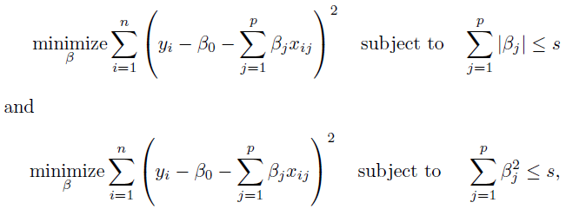
The Lasso (cont.)
One can show that the lasso and ridge regression coefficient estimates solves the problems:

Slide 56
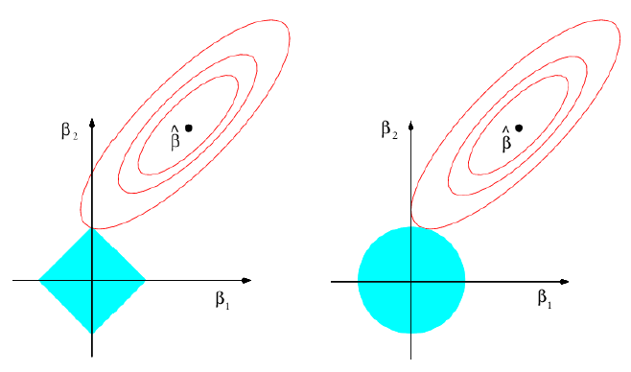
The Lasso (cont.)
The lasso and ridge regression coefficient estimates are given by the first point at which an ellipse contacts the constraint region.
OLS Solution
Ridge Regression
Lasso

Slide 57
Lasso vs. Ridge Regression
The lasso has a major advantage over ridge regression, in that it produces simpler and more interpretable models that involved only a subset of predictors.
The lasso leads to qualitatively similar behavior to ridge regression, in that as λ increases, the variance decreases and the bias increases.
The lasso can generate more accurate predictions compared to ridge regression.
Cross-validation can be used in order to determine which approach is better on a particular data set.

Slide 58
Selecting the Tuning Parameter λ
As for subset selection, for ridge regression and lasso we require a method to determine which of the models under consideration in best; thus, we required a method selecting a value for the tuning parameter λ or equivalently, the value of the constraint s.
Select a grid of potential values; use cross-validation to estimate the error rate on test data (for each value of λ) and select the value that gives the smallest error rate.
Finally, the model is re-fit using all of the variable observations and the selected value of the tuning parameter λ.

Slide 59

Selecting the Tuning Parameter λ: Credit Data Example

Slide 60

Selecting the Tuning Parameter λ: Simulated Data Example

Slide 61
Logistic Regression
Recall that linear regression assumes the response is quantitative
In many cases, the response is qualitative (categorical).
Here, we study approaches for predicting qualitative responses, a process that is known as classification.
Predicting a qualitative response for an observation can be referred to as classifying that observation, since it involves assigning the observation to a category, or class.

Slide 62

Why not Linear Regression in Classification Problem
Linear regression is unbounded

Slide 63


Logistic Regression Model
The hypothesis of linear regression hθ(x) could produce probabilities less than zero or greater than one.
To fix this, let’s change the form for our hypotheses hθ(x). We will choose
is called the logistic function or the sigmoid function.

Slide 64

Standard logistic function

Slide 65

Using a logistic regression model

Slide 66


Slide 67


Slide 68


Slide 69


Slide 70


Slide 71
Types of Logistic Regression
Binary Logistic Regression
The categorical response has only two 2 possible outcomes. Example: Spam or Not
Multinomial Logistic Regression
Three or more categories without ordering. Example: Predicting which food is preferred more (Veg, Non-Veg, Vegan)
Ordinal Logistic Regression
Three or more categories with ordering. Example: Movie rating from 1 to 5

Slide 72
Decision Boundary
To predict which class a data belongs, a threshold can be set. Based upon this threshold, the obtained estimated probability is classified into classes.
Say, if predicted_value ≥ 0.5, then classify email as spam else as not spam.
Decision boundary can be linear or non-linear.
Polynomial order can be increased to get complex decision boundary.

Slide 73


Slide 74


Slide 75

GDA for Logistic Regression

Slide 76


Slide 77
References
https://people.eecs.berkeley.edu/~jordan/courses/294-fall09/lectures/regression/slides.pdf
https://www.easycalculation.com/analytical/learn-least-square-regression.php
http://courses.washington.edu/css490

